Slide 2
Correlation Heatmap

Slide 3
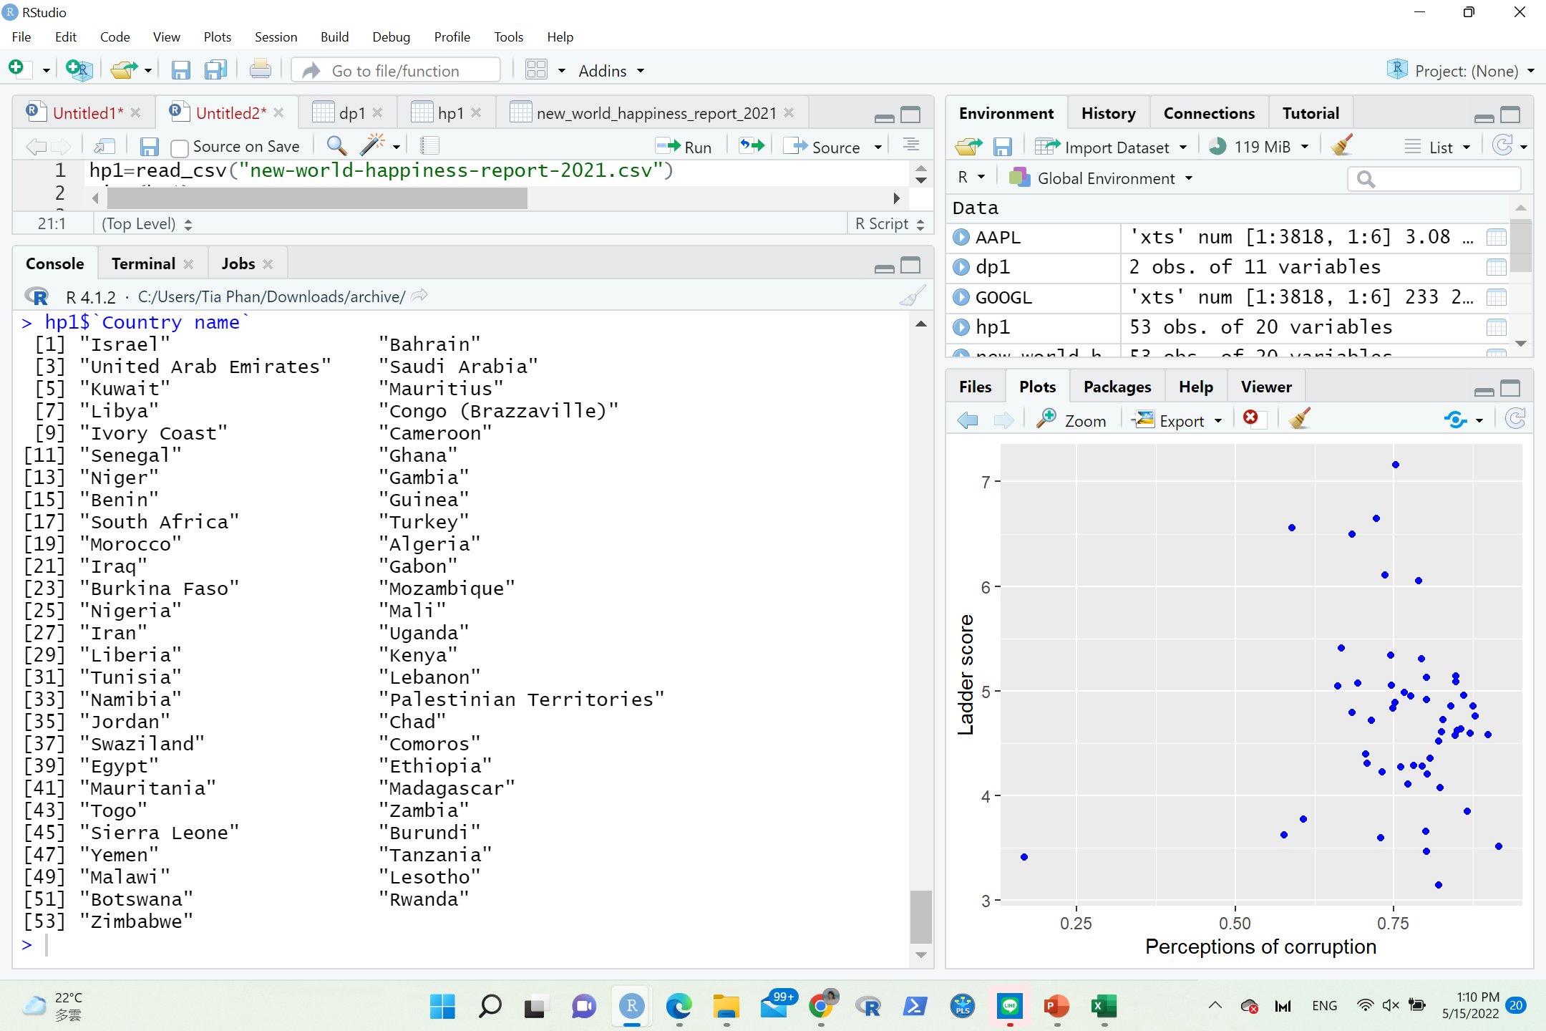

Slide 4
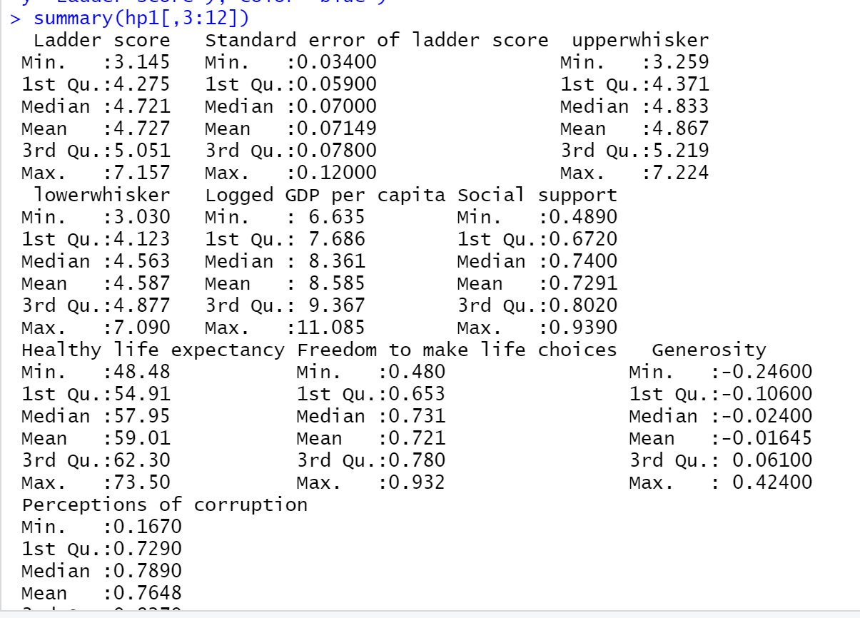
Notes:
In 2021, with a total count of 149 countries, the average or mean of all happiness scores is about 5.532839. Finland has the highest score of 7.842, and Afghanistan has the lowest score of 2.523. More than 30 countries have the score above 6.255, and more than 30 counties have happiness scores below 4.85. The median and mean are very close as the difference between them is only 5.534 - 5.5328.

Slide 5
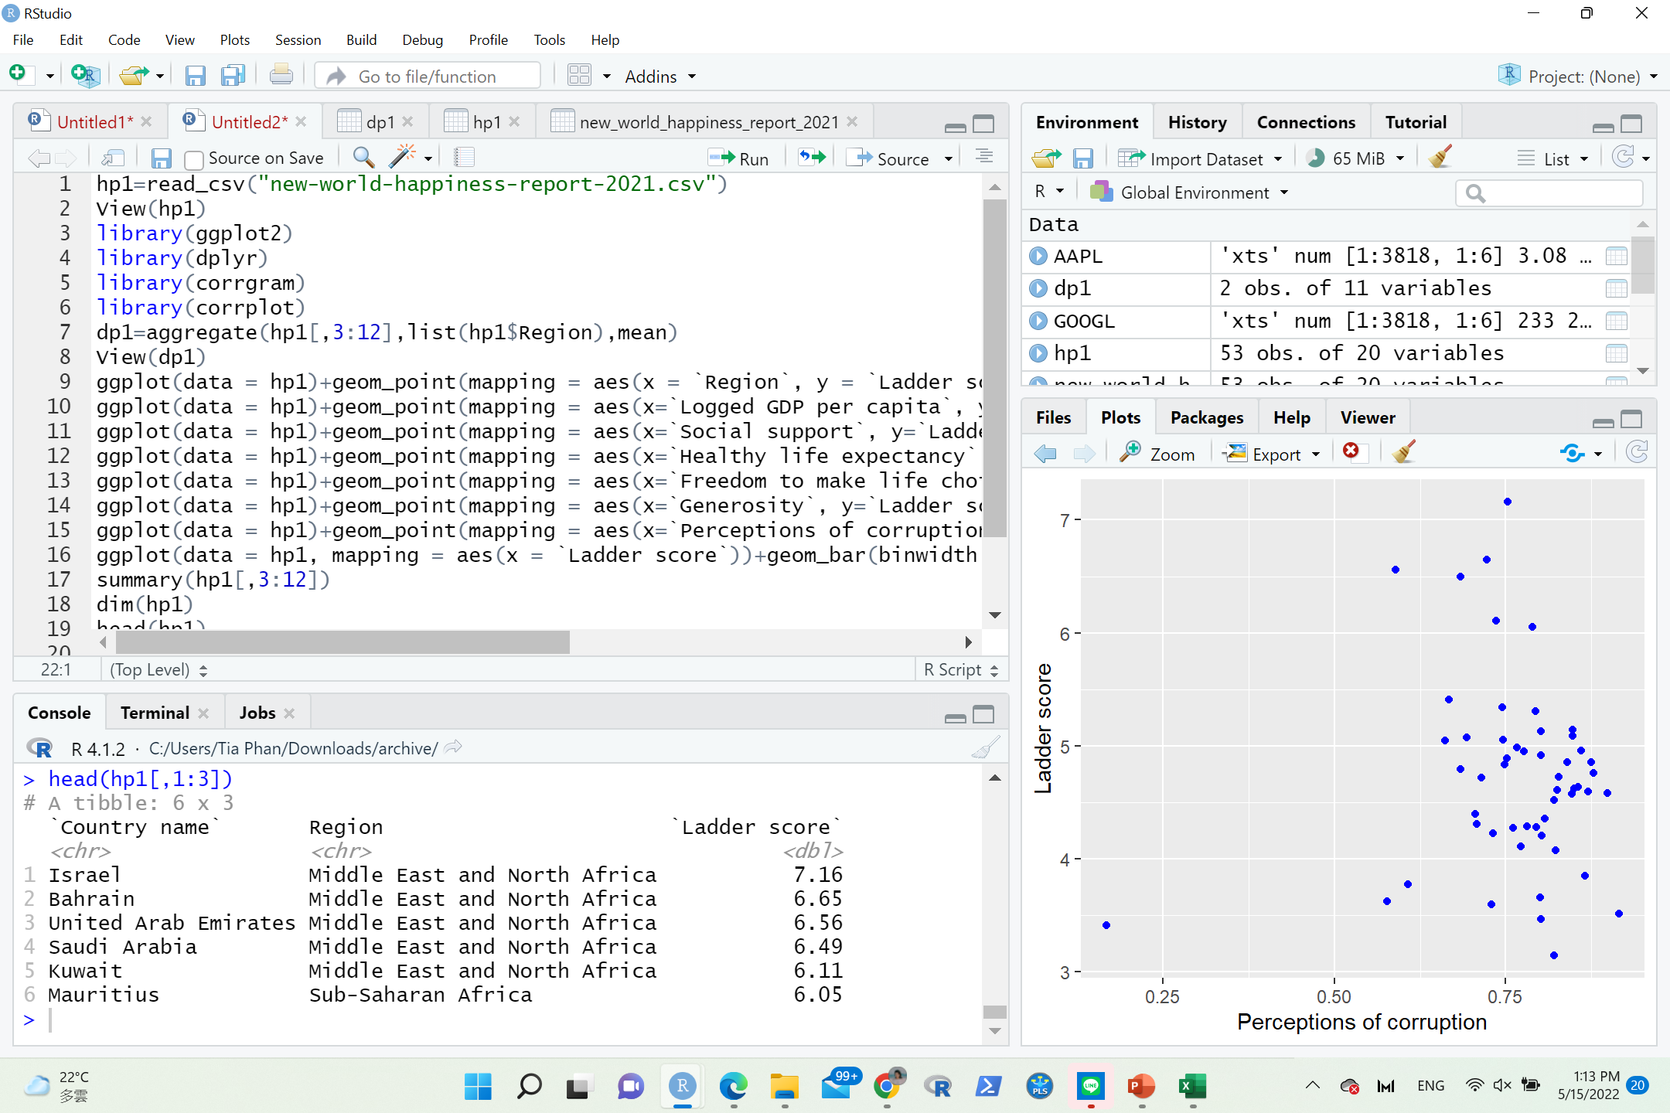
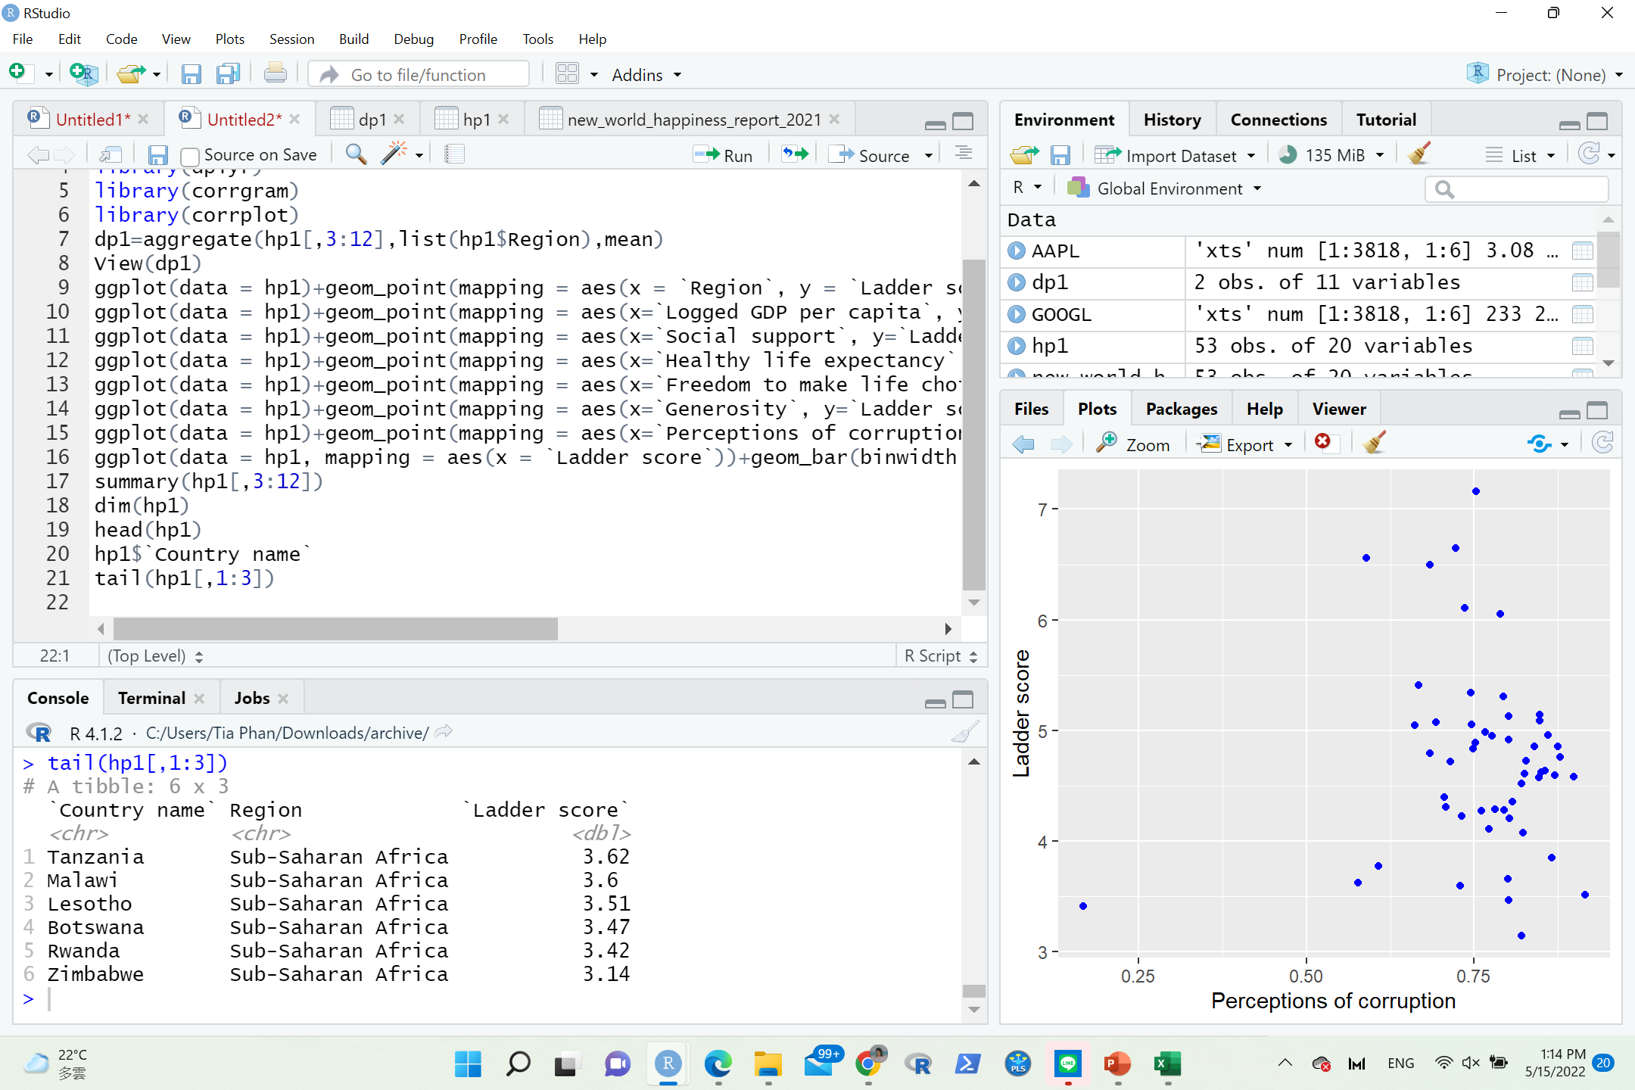

Slide 6
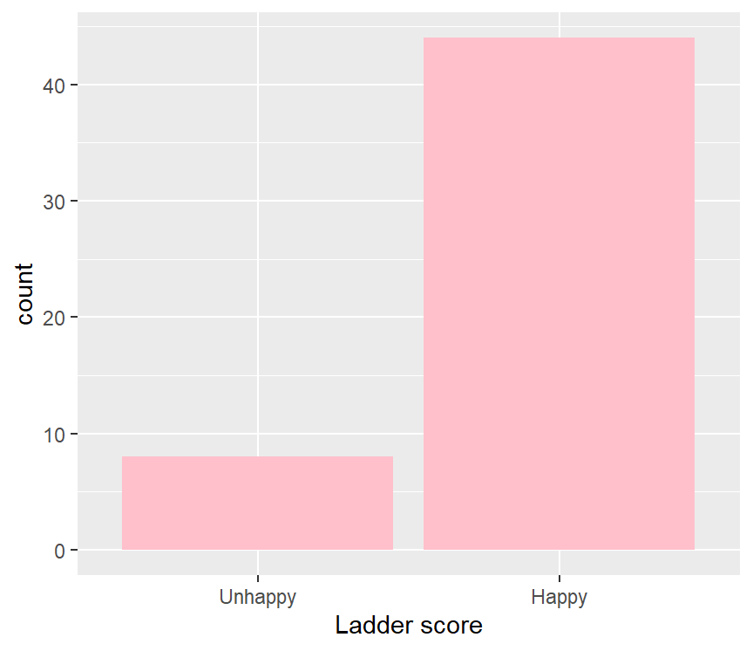
ggplot(na.omit(hp1),aes(`Ladder score`))+geom_bar(fill="pink")

Slide 7
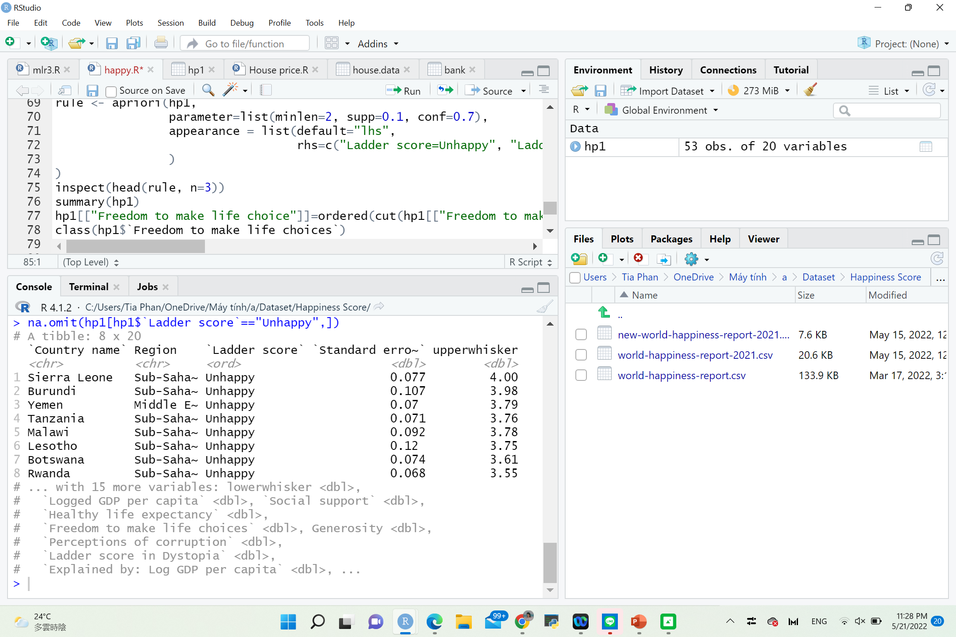

Slide 8
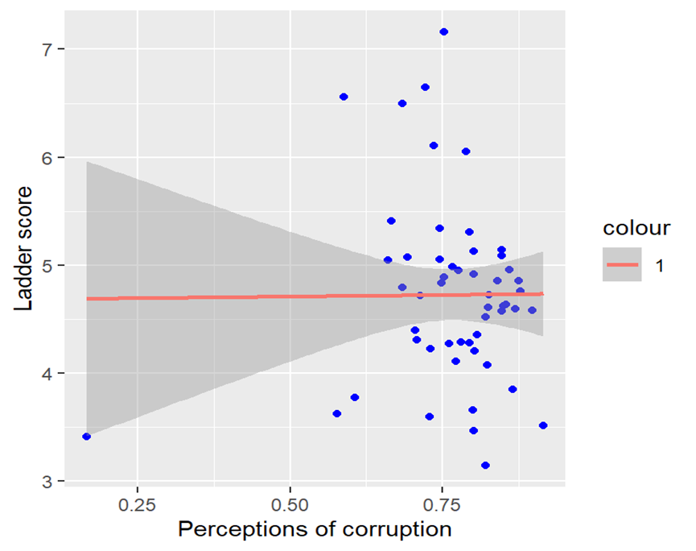
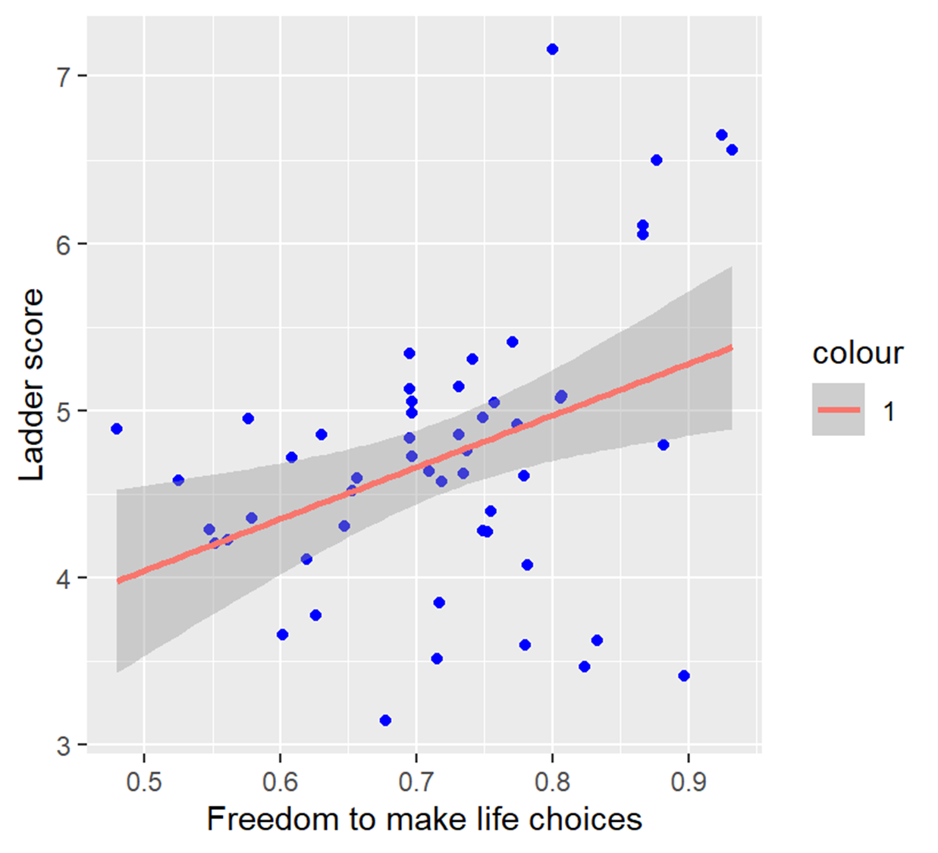
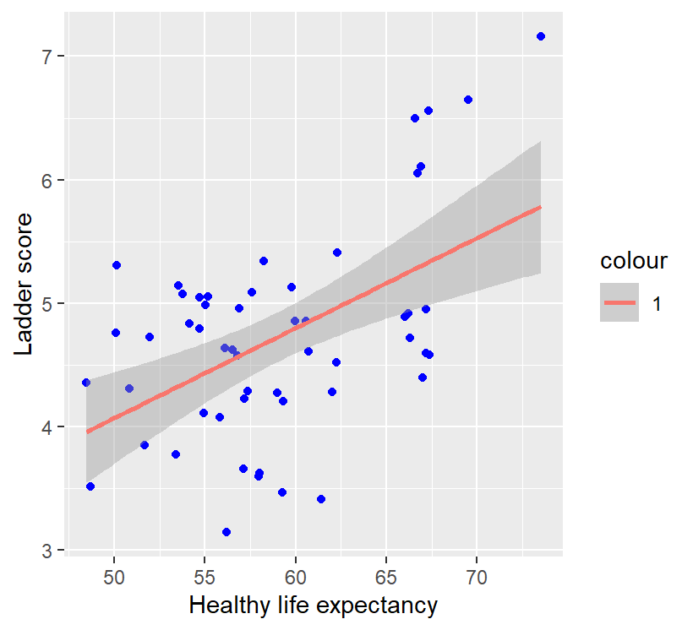
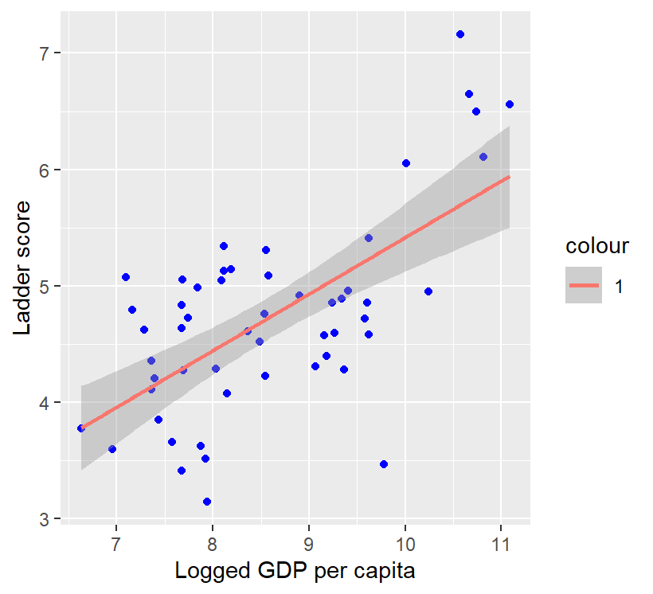
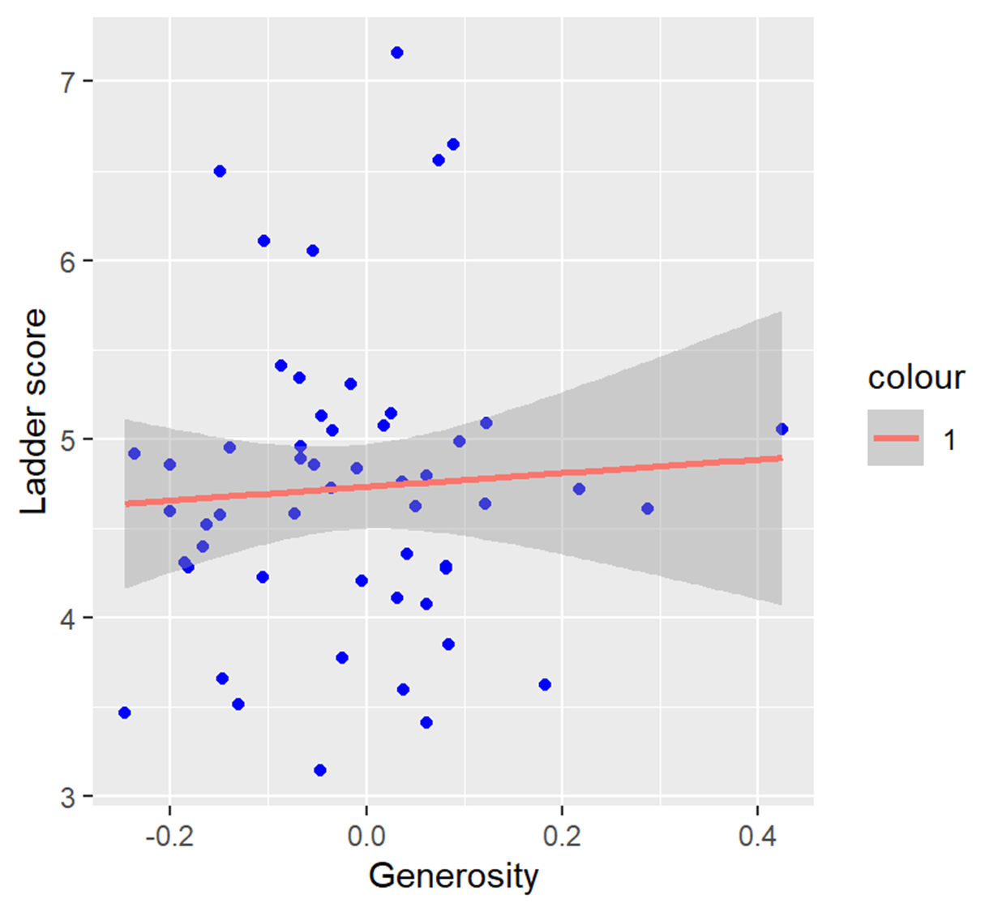
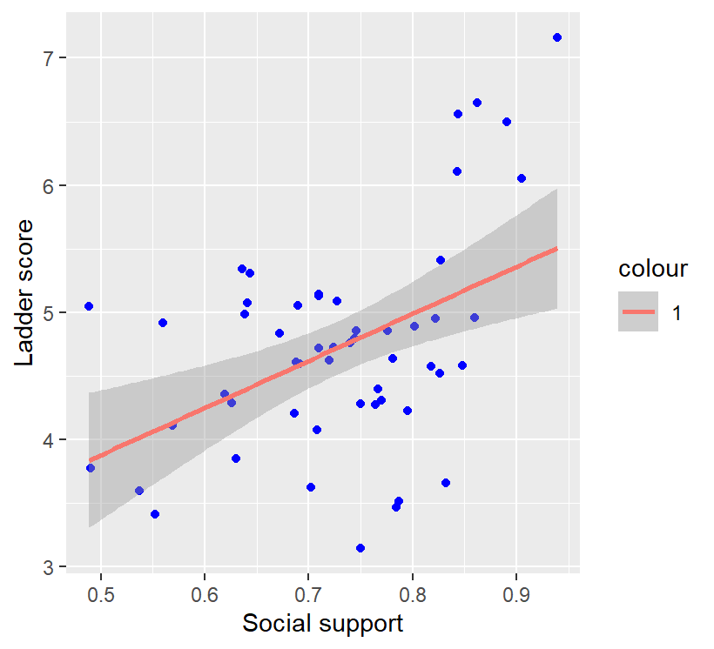

Slide 9
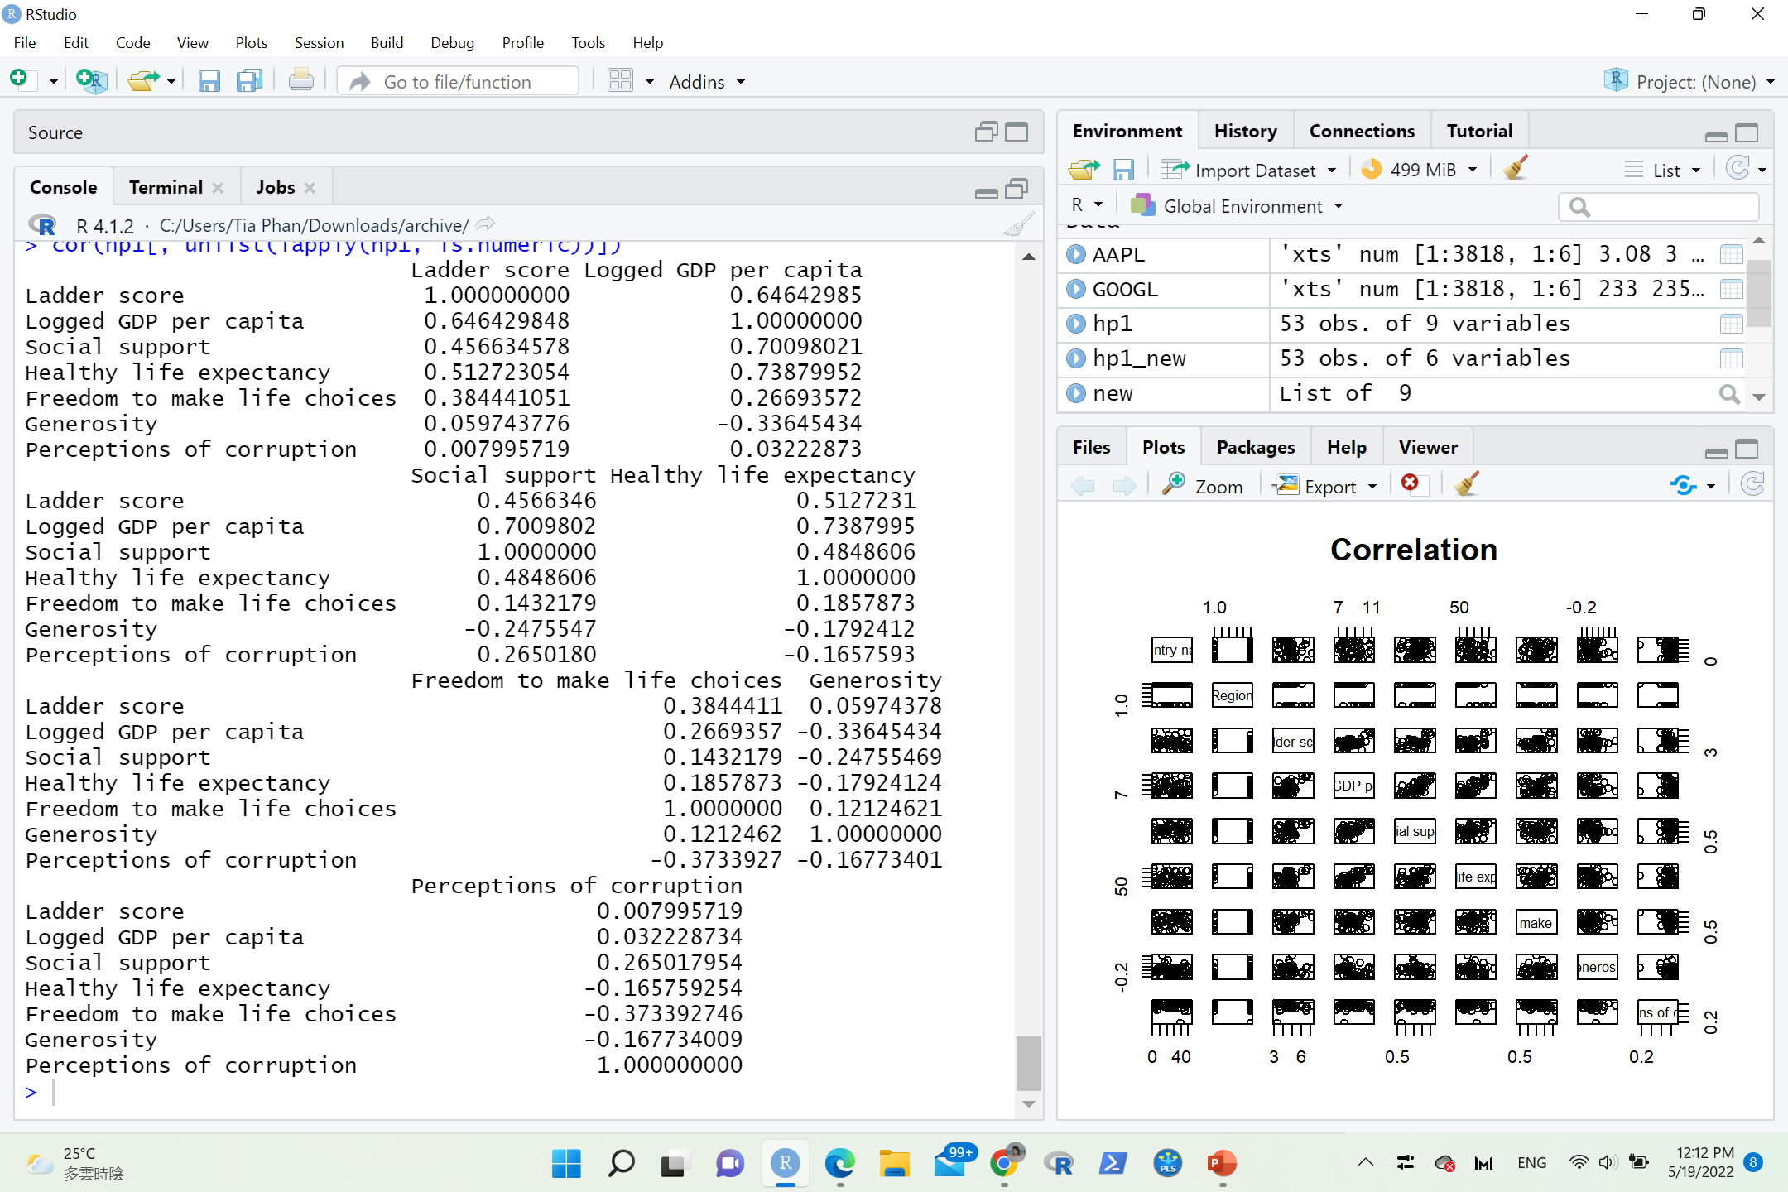
Correlation
cor(hp1[, unlist(lapply(hp1, is.numeric))])

Slide 10

The final three lines are model diagnostics – the most important thing to note is the p-value (here it is 2.2e-16, or almost zero), which will indicate whether the model fits the data well.
From these results, we can say that there is a significant positive relationship between income and happiness (p-value < 0.001), with a 0.486-unit (+/- 0.01) increase in happiness for every unit increase in income.

Slide 11
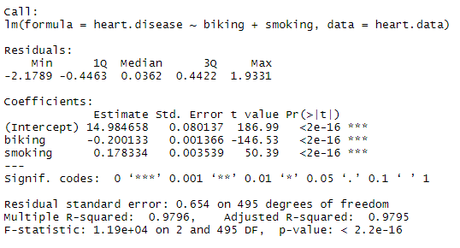

The estimated effect of biking on heart disease is -0.2, while the estimated effect of smoking is 0.178.
This means that for every 1% increase in biking to work, there is a correlated 0.2% decrease in the incidence of heart disease. Meanwhile, for every 1% increase in smoking, there is a 0.178% increase in the rate of heart disease.
The standard errors for these regression coefficients are very small, and the t-statistics are very large (-147 and 50.4, respectively). The p-values reflect these small errors and large t-statistics. For both parameters, there is almost zero probability that this effect is due to chance.

Slide 12


Slide 13



